Slide 1

Database Management Systems Image to Text
By
Under the guidance of
P. Sree Lakshmi
Roll Number | Name
2110030359 | B Chihnita Reddy
2110030320 | SIRISILLA Nikhitha Reddy
2110030284 | Shivani Konduri
2110030283 | N Rajashri

Slide 2
Image To Text
Our goal is to convert a given text image into a string of text.
Converting scanned typed, handwritten, or printed text into machine-encoded text.
It is widely used as a form of data entry from printed paper data records, whether passport documents, invoices, bank statements, bills, receipts, etc. Computer software is used to convert scanned text back into editable text.

Slide 3
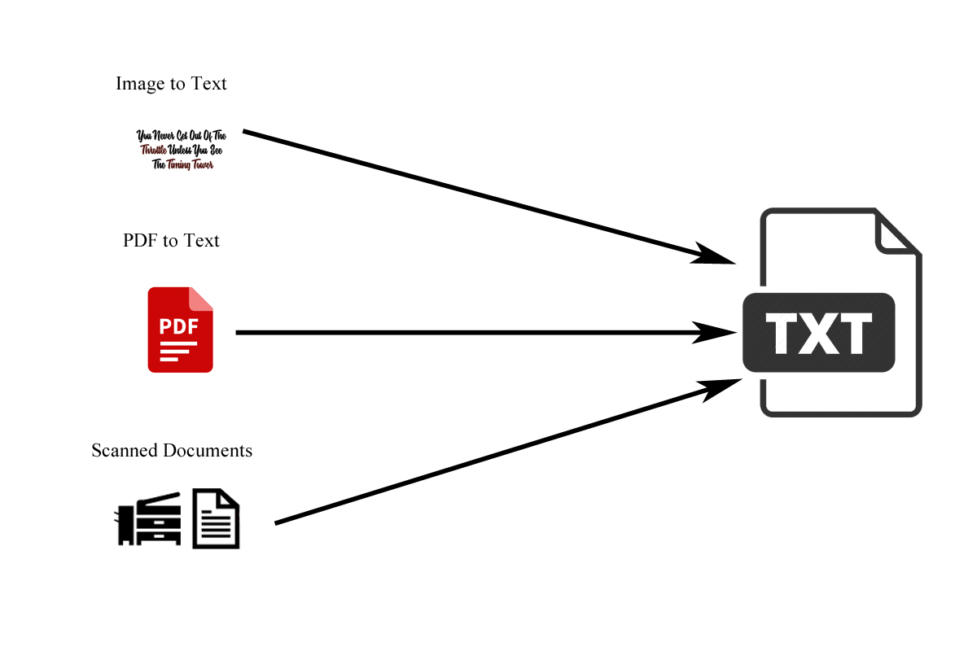

Slide 4
Existing solutions/ Naïve solutions
OCR (optical character recognition or optical character reader) is the electronic or mechanical conversation of images of typed, handwritten, or printed text into machine-encoded text, whether from a scanned document, a photo of a document, or a photo of a document.
When users take a picture of their ID document with their smartphone or webcam, multiple steps are required to extract and structure the information.
OCR text works efficiently with the printed text only and not with handwritten text. Handwriting must be learned by the pc.

Slide 5
Drawbacks
OCR systems are expensive.
There is the need of a lot of space required by the image produced.
The quality of the image can be lost during this process.
Quality of the ultimate image depends on the quality of the first image.
All the documents got to be checked over carefully and then manually corrected. Not 100% accurate, there are likely to be some mistakes made during the method.

Slide 6
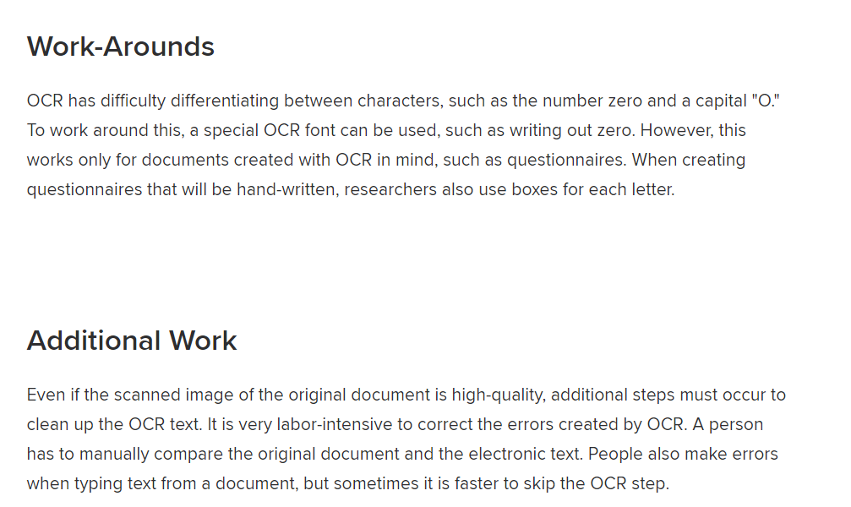

Slide 7
Proposed Algorithm Design Technique
The technique is the development of applications.
It is helpful for all the students, and employees for their work in all the ways.
Using the proposed design method is easily accessible without any flaws, advertisement, and premium nature.
You can use infinite times it gives the accurate content given in the image.

Slide 8
Data Structures needed
Often images are just represented as large bi-dimensional arrays; what you try to optimize are the algorithms you run on them.
You also have fractal image compression, which is representing the whole image as a mathematical function. That's cool but that's not often used for real applications.

Slide 9
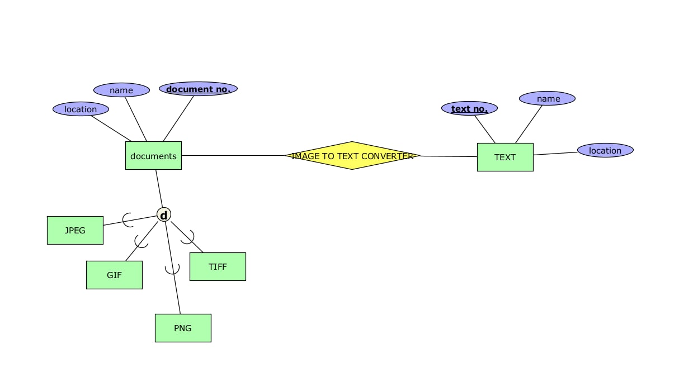

ER Model Diagram

Slide 10
Literature Review
https://www.geeksforgeeks.org/advantages-and-disadvantages-of-optical-character-reader-ocr/
https://theenterpriseworld.com/7-benefits-of-image-to-text-converter/
https://tweakyourbiz.com/business/technology-trends/top-8-benefits-of-an-image-to-text-technology-for-your-business

Slide 11
GitHub setup
https://github.com/CHIHNITA-REDDY-B
https://github.com/NIKHITHA-SIRISILLA
https://github.com/KONDURISHIVANI
https://github.com/RAJASHRINOULURI

Slide 12
Division of work among the group members
2110030359- Web Application
2110030320-Web Application
2110030284-Researching
2110030283-Software requirements

Slide 13


